Slide 1
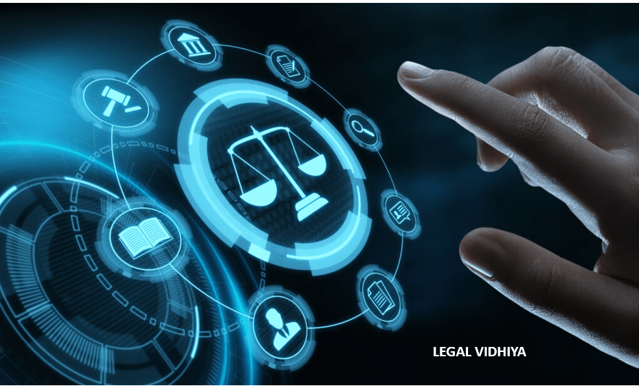

Cybersecurity and Law Cross-Disciplinary Project
Team Lead: Julian Taylor Lead Researcher: Jamari Anderson, Isiah Gohagen Lead Presenter: Sade Watson Team Collaborators: Kenice Barrett, Ian Rios

Slide 2
WHAT WE’LL BE COVERING
What is CIRCIA?
The history and context
CIRCIA vs CISA
Cases related to CIRCIA
Unintended consequences of CIRCIA
The effectiveness of CIRCIA
How CIRCIA can be improved
Benefits and challenges of CIRCIA

Slide 3


What is CircIa?
Cyber Incident Reporting for Critical Infrastructure Act of 2022 (CIRCIA)
Requires critical infrastructure sectors to report cybersecurity incidents and ransomware payments to CISA, supporting proactive threat analysis and response.

Slide 4
The history and context of CIRCIA
CIRCIA was proposed because of the increase of cyber-attacks on critical infrastructure.
Signed into law by Joe Biden in March of 2022
The 2021 Colonial Pipeline ransomware incident was a key factor in driving congress to approve of CIRCIA.
Notes:
. These reports will allow CISA to rapidly deploy resources and render assistance to victims suffering attacks, analyze incoming reporting across sectors to spot trends, and quickly share that information with network defenders to warn other potential victims.

Slide 5

CIRCIA vs. CISA
CIRCIA mandates reporting while CISA focuses on voluntary data sharing.
CIRCIA requires to report cyberattacks in 72 hours and ransomware attacks in 24.
The importance of critical infrastructure requires stricter management than regular companies which is why CIRCIA is mandated.
Notes:
To clear up confusion, there is an act and an agency under the same name, CISA. One is an agency under the Department of Homeland Security, while one is a law that encourages sharing information regarding cyber incidents. CIRCIA is specific to critical infrastructure which is managed by the CISA agency.

Slide 6
Cases Related to CIRCIA and Its Impact
Colonial Pipeline Ransomware (2021)
A major fuel pipeline system in the United States, suffered a ransomware attack.
NotPetya “Ransomware” (2017)
Hospitals and other critical infrastructure companies were affected with damaged hard drives and encrypted data.
Notes:
Colonial Pipeline:
Cause: The attack was attributed to a hacker group called DarkSide. They infiltrated Colonial Pipeline's systems through weak credentials and exploited a vulnerable VPN. Impact: The attack forced Colonial Pipeline to shut down operations for several days, leading to panic buying and fuel shortages across the East Coast. This disruption highlighted the nation's dependence on this single pipeline for fuel delivery. Resolution: Colonial Pipeline eventually paid a ransom of 75 bitcoin (around $4.4 million at the time) to regain access to their systems.
NotPetya Ransomware Attack (2017):
This global ransomware attack, believed to be orchestrated by Russia, disrupted operations for many organizations worldwide, including several in the US. The NotPetya malware went beyond just encrypting data; it also damaged hard drives, rendering them unusable. Hospitals, shipping companies, and pharmaceutical companies were among those affected in the US.

Slide 7


The unintended consequences of CIRCIA
Deters the incentive of reports relating to that of ransomware attacks.
Increases the burden on critical infrastructure operators on strict deadlines.
If these deadlines are not met, then the fines can go up to $50,000 per violation per day depending on the organizations' size

Slide 8
Effectiveness of CIRCIA
Although CIRCIA has not been around for long it has been effective, by:
Increasing security
Helping companies to defend against cyber threats with information from the reports
CIRCIA has made CISA prioritize cybersecurity as shown by CISA's establishment of:
The Joint Ransomware Task Force (JRTF) in September 2022
Ransomware Vulnerability Warning Pilot (RVWP) Program in January 2023
Notes:
CISA and the Federal Bureau of Investigation (FBI) established the Joint Ransomware Task Force (JRTF) in September 2022 a nationwide campaign against ransomware attacks.
Ransomware Vulnerability Warning Pilot (RVWP) Program in January 2023 to identify the most common security vulnerabilities used in ransomware attacks and to identify information systems that already contain these vulnerabilities.
Together, JRTF and RVWP are making Americans safer and better equipped to handle cyber incidents.

Slide 9
How Can CIRCIA Be Improved?
Effective Reporting Process:
Concise questioning
Clear guidelines
User-friendly interfaces
Incentives for Reporting:
Liability protections from lawsuits
Recognition
Tax Incentives such as tax deductions
Notes:
Because It requires covered entities to report cyber incidents within a short time period for a report so they should
Another way CIRCIA can be improved is through a simplified reporting proccess which will encourage timely and accurate submissions.
It essentially says that if an organization or one of these covered entities does make a cyber incident report or ransomware payment report to the Department of Homeland Security that they’re shielded from lawsuits based solely on the report being made.

Slide 10
The benefits and challenges of CIRCIA
Benefits
Challenges
Accountability
Knowledge sharing
Risk Mitigation
Information Quality
Funding Constraints
Global Reach Considerations

Slide 11
Citations
History and context: NY Times
https://obamawhitehouse.archives.gov/the-press-office/2013/02/12/presidential-policy-directive-critical-infrastructure-security-and-resil:
Answers to Common Questions Regarding New CIRCIA | Perkins Coie
Linked In
https://www.jdsupra.com/legalnews/cisa-s-proposed-cyber-incident-2271397/
https://cyberscoop.com/cisa-circia-cyber-incident-reporting/

